Slide 1


Slide 2
While the anatomy of the different layers is fairly well defined [1, 2, 3, 4],
the roles of the different layers in cortical processing are still poorly understood, and their elucidation remains a central challenge for systems neuroscience [5].

Slide 3
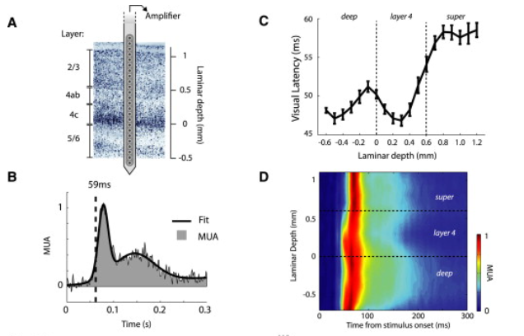

Slide 4
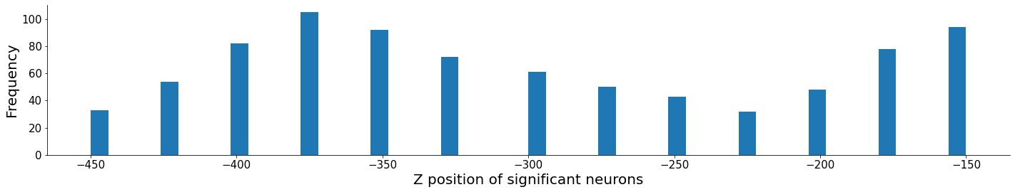
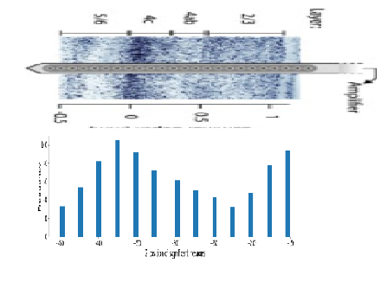

Slide 5
Recording sites between 0.7 and 0.1 mm below the 4c/5 boundary were assigned to the deep layers, sites between 0 and 0.2 mm above the boundary were assigned to layer 4c, sites between 0.3 and 0.5 mm were assigned to upper layer 4 (which we refer to as layer 4ab), and sites more than 0.5 mm above the boundary were assigned to the superficial layers. Recording sites more than 0.7 mm below or more than 1.1 mm above the boundary were removed from the analysis because we did not obtain sufficient data from these very deep and very shallow locations (14.9% of all recording sites).

Slide 6
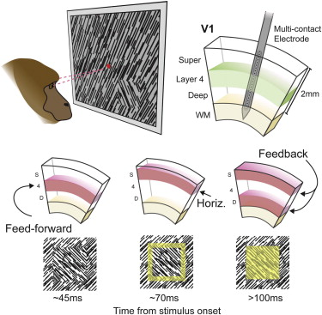
Here: examined the role of the layers in the primary visual cortex (V1) of monkeys.

Slide 7
V1 receives feedforward connections from the lateral geniculate nucleus (LGN) that terminate primarily in layers 4 and 6 .
there are horizontal connections between the V1 columns that are present in all layers but predominantly terminate in upper layer 4 and the superficial layers
there are feedback connections from higher visual areas, which terminate primarily in layers 1 and 5 and tend to avoid layer 4

Slide 8
To determine the role of the layers, we used a texture-segmentation task , because studies have suggested that cortical processing in this task consists of a number of processing phases for which feedforward, horizontal, and feedback connections play different roles.

Slide 9
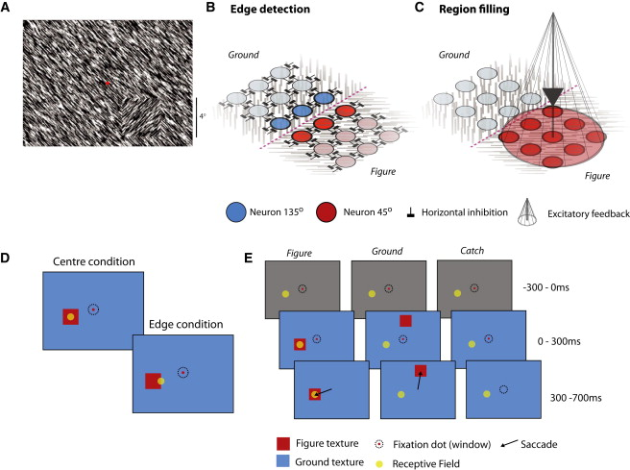

Slide 10
the orientation of the line elements is extracted by the spatial arrangement of feedforward connections from the LGN to V1
the edges between figure and background are detected at locations where the orientation changes abruptly, This is thought to be achieved through horizontal inhibition between neurons with nearby receptive fields (RFs) tuned to the same orientation
neuronal responses evoked by the figure are enhanced relative to the background, an effect known as figure-ground modulation (FGM) [22]. FGM in the figure center is thought to arise from feedback projections from higher visual areas back to V1, as it is modulated by attention [18] and is absent when a monkey fails to detect the figure

Slide 11
One possibility is that neurons in the superficial layers must summate the input from layer 4 for a longer period before they reach spike threshold. Layer 5 neurons receive a small amount of direct input from layer 4
We also observed a laminar difference in the balance between transient and sustained activity. Layers 4 and 6 had a strong transient response, but their activity decreased after ∼100 ms. Visually driven activity was more sustained in the superficial layers and layer 5 [33], and these layers may therefore play an important role in representing the stimulus at later times.

Slide 12
Layer 4c neurons have only few dendrites extending into layers 1, 2, and 5 [2], which might cause them to receive little feedback from higher areas, and this could explain the weak FGM in this layer. However, it is also conceivable that the weaker FGM in layer 4 is the result of the weaker level of sustained activity. Previous studies suggested that feedback effects are particularly pronounced for neurons that are well driven by a stimulus and weaker for neurons that are not [48, 49]. Such a multiplicative interaction between feedback effects and visually driven activity could be conveyed by NMDA receptor-mediated feedback [50]. NMDA receptors only pass current if the membrane is depolarized, which could explain why FGM is strongest in layers with a high level of sustained activity.

Slide 13
https://www.sciencedirect.com/science/article/pii/S0960982213011299#:~:text=V1%20receives%20feedforward%20connections%20from,9%5D%2C%20and%20there%20are%20feedback

Slide 14
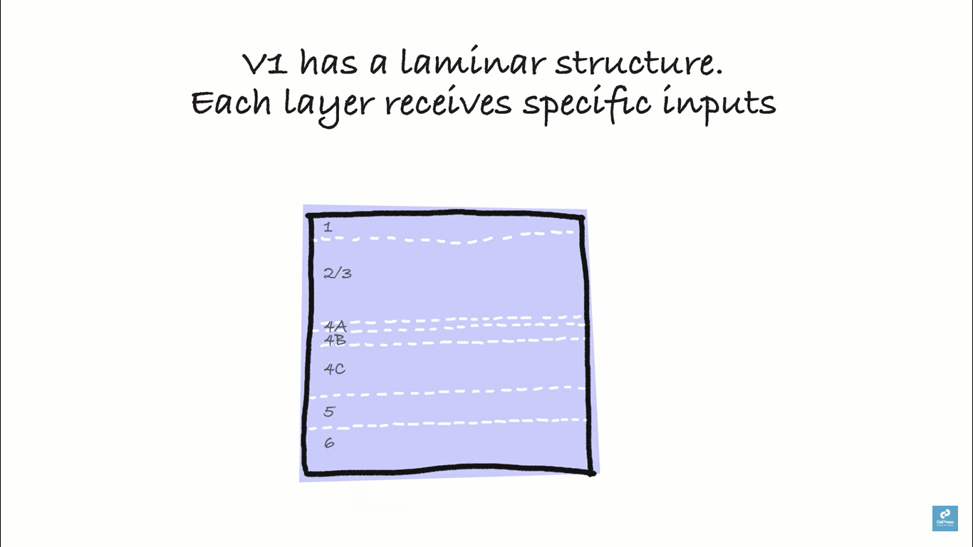

Slide 15
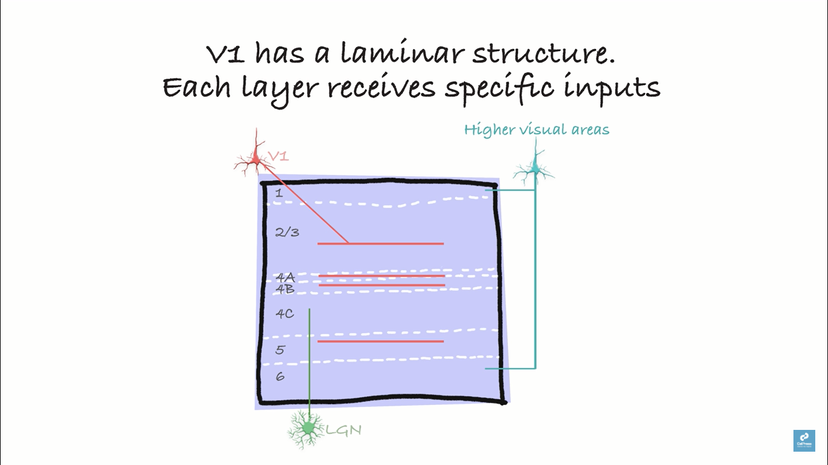
Notes:
Feedback from higher areas

Slide 16
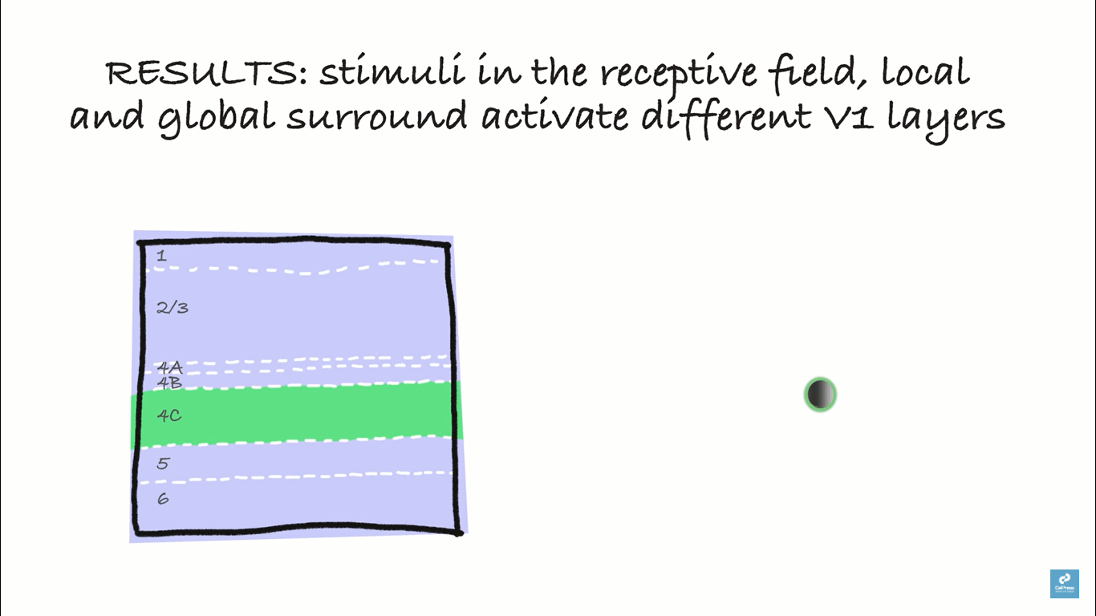
Notes:
Response to small stimulus inside receptive field, later 4c was activated first

Slide 17
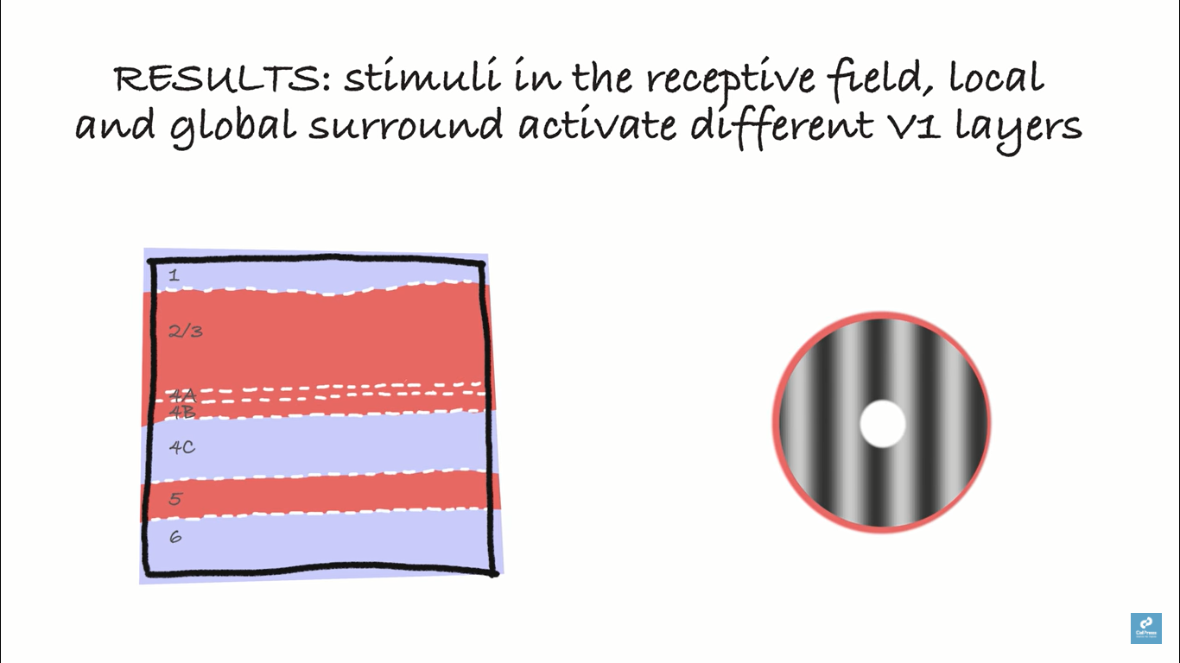
Notes:
Local surround

Slide 18
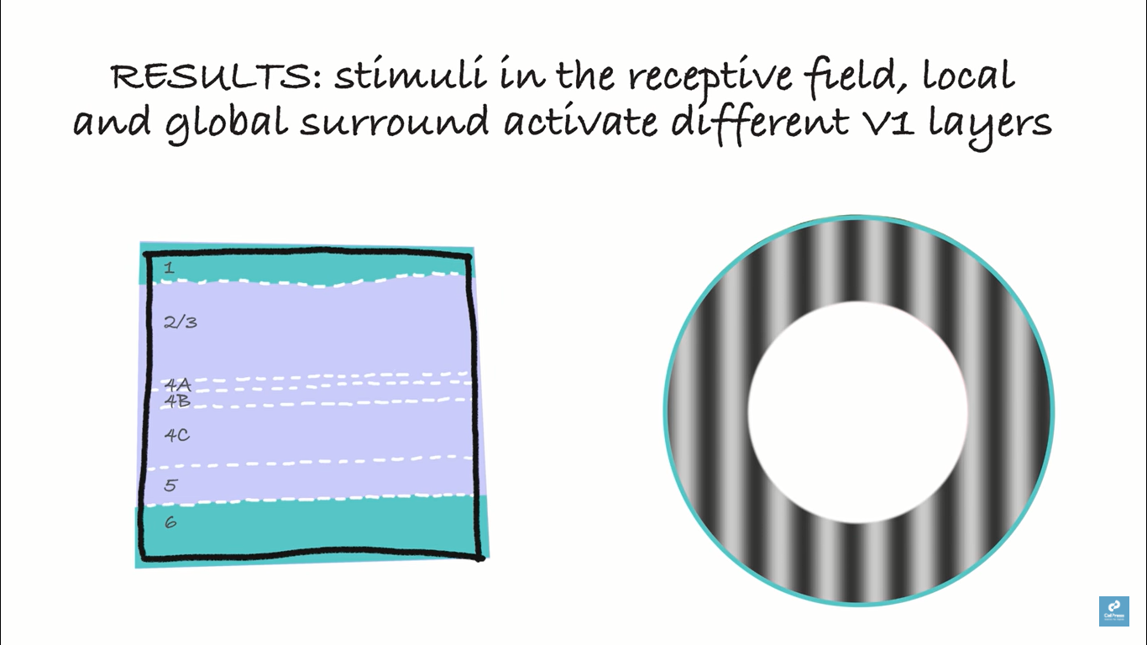

Slide 19
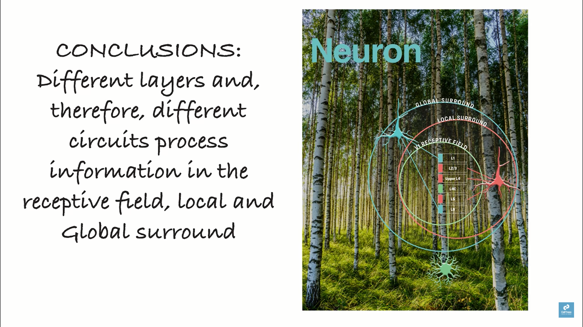
Notes:
Input from LGN carry visual information to the receptive field, long range horizontal connections within V1 carry the visual information from near surround to V1 column, and feedback connections from higher visual areas carry the visual information from far surround

Slide 20
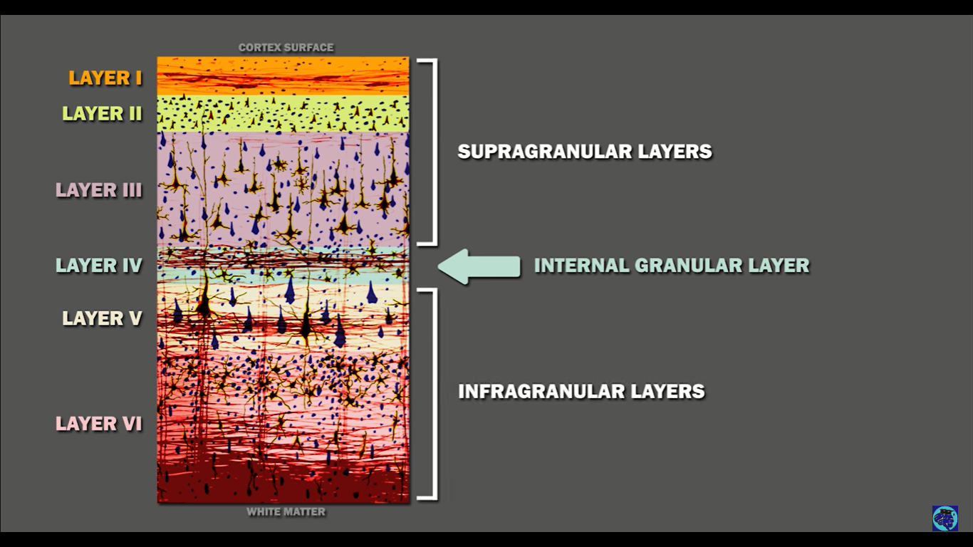

Slide 21
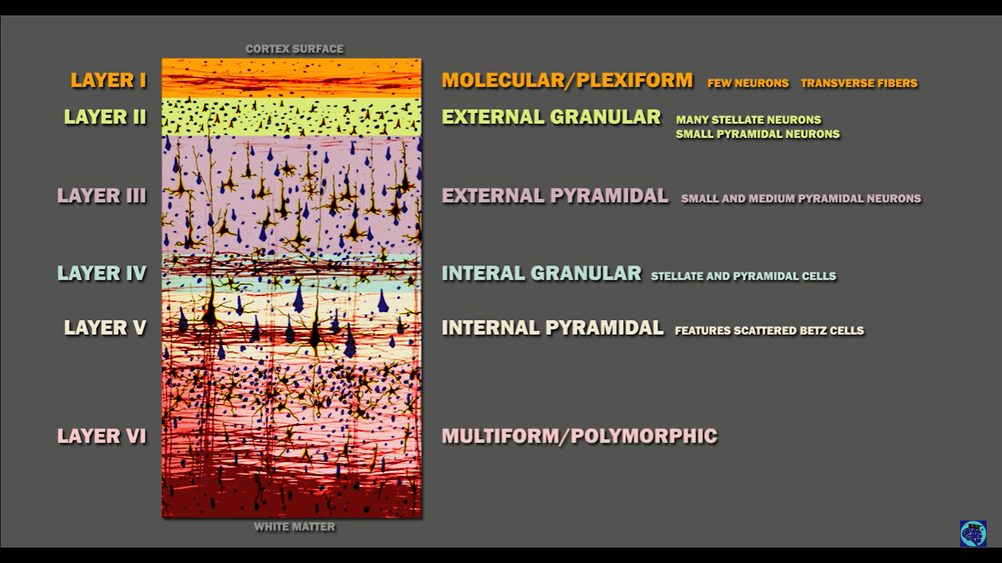

Slide 22
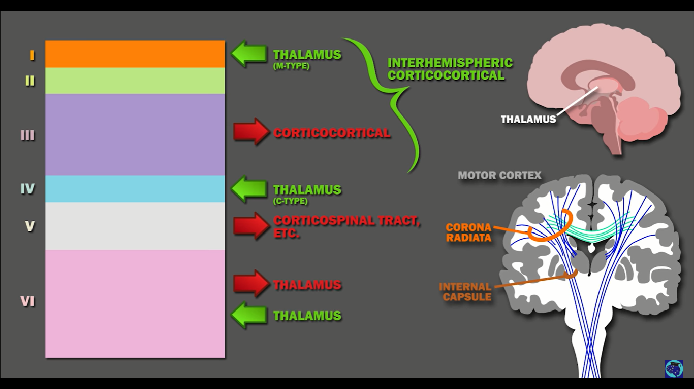

Slide 23
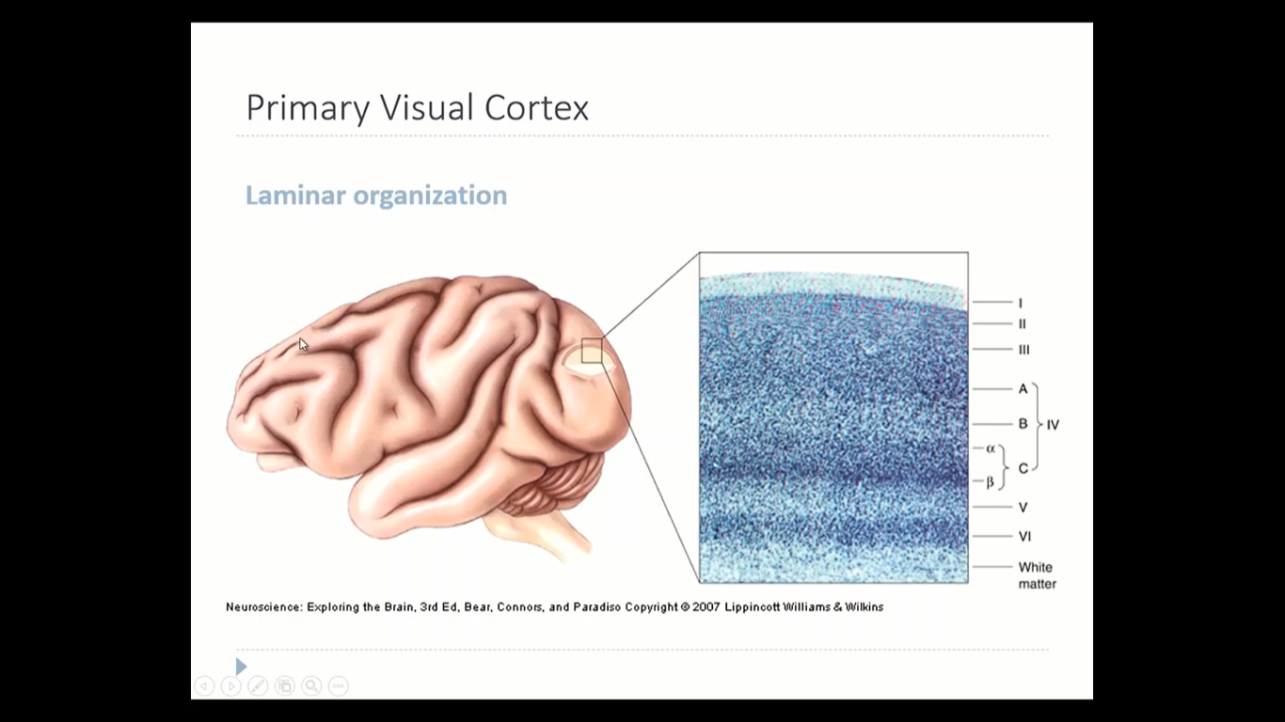

Slide 24
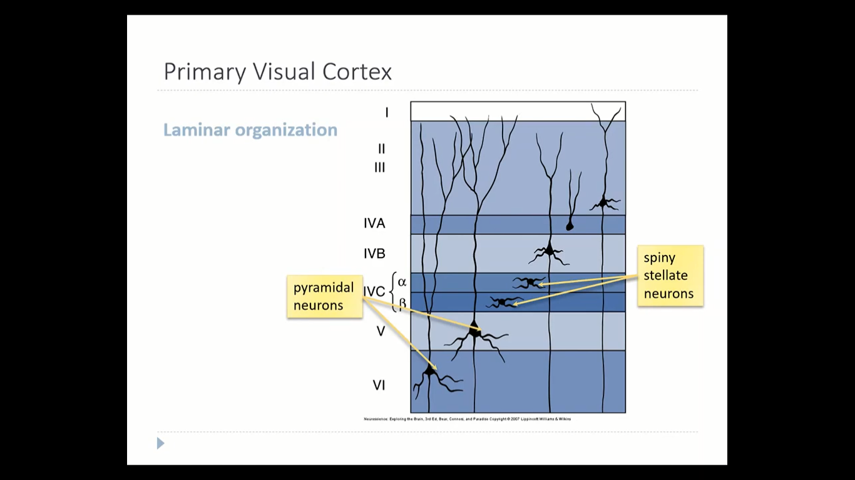

Slide 25
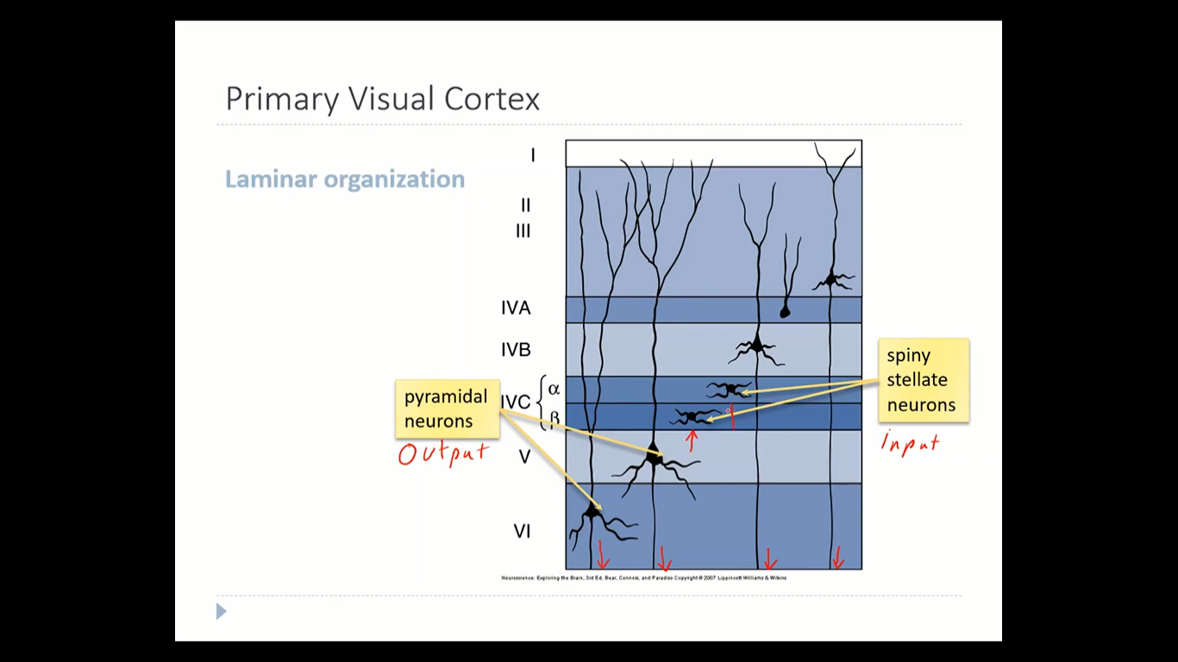

Slide 26
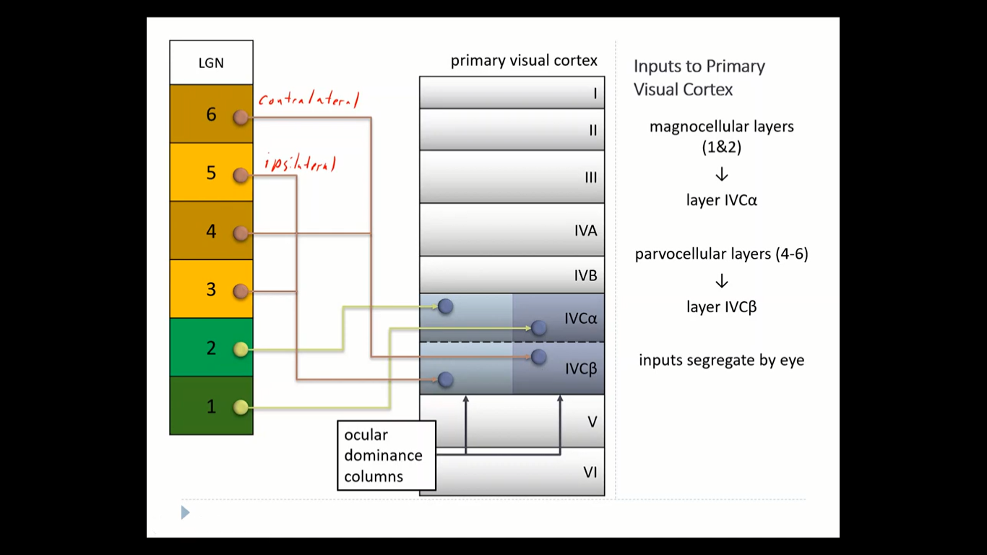

Slide 27
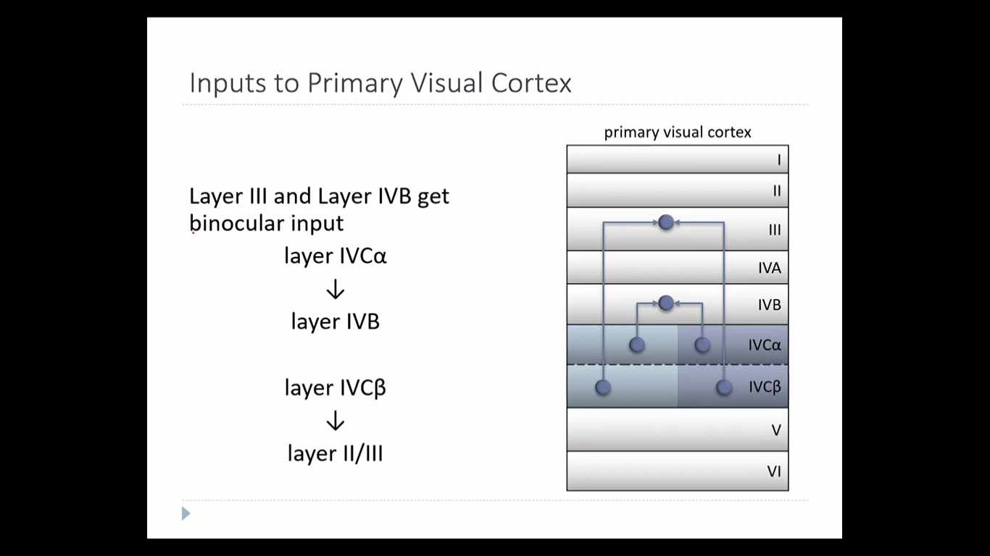

Slide 28
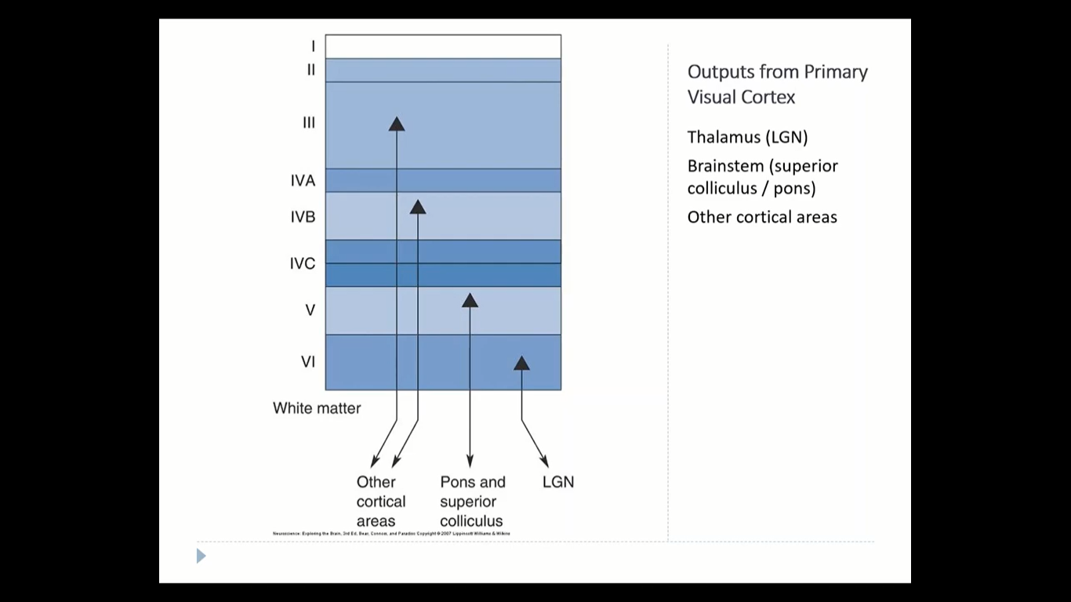

Slide 29
Area V1 differs from other cortical areas also by having a higher density of neurons, particularly in layer 4 (Rockel et al., 1980). This layer is packed with spiny stellate cells (Douglas and Martin, 1998).
In primates including humans, layer 4 is visible to the naked eye even in an unstained section, thanks to a thick band of myelinated axons traveling from sublayers 4Ca to 4B, the stria of Gennari. Because of this band, V1 is historically called "striate cortex", and the term "extrastriate" denotes the rest of visual cortex.

Slide 30
Stringer-paper1
Data acquisition
We optically recorded neural activity in head-fixed awake mice implanted with 3-4 mm cranial windows centered
over visual cortex, obtaining 10,000 neurons in all recordings. The recordings were performed using multi-plane
acquisition controlled by a resonance scanner, with planes spaced 30-35 m apart in depth. 10 or 12 planes were
acquired simultaneously at a scan rate of 3 or 2.5 Hz.

Slide 31
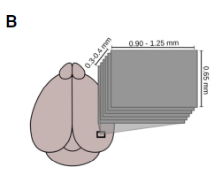
Stringer-paper2
Our main stimuli were static gratings of a random orientation on each trial, which lasted for 750 ms, followed by 250 ms of gray screen.
For almost all experiments, an area of 1mmby 650 mm was acquired. In a subset of experiments (’’localized’’ with dense stimulus set), we used a much larger recording area of 232 mm (three stripes of 650 mm width) to match the recording area from Rumyantsev et al. (2020).
We recorded neural activity from visual cortex using multi-plane two-photon calcium imaging, with 10–17 planes spaced 25 um apart in depth, scanning the entire stack repeatedly at an average of 3 Hz (Figure1B).

Slide 32
Figure S5. Discrimination thresholds for different stimuli and behavioral state changes, related to Figure 2
(K) Discrimination using only neurons at depths 125-225 mm (left) and at depths 375-475 mm (right)

Slide 33
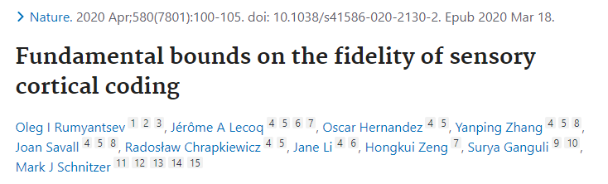
We studied layer 2/3 pyramidal neurons, which project extensive connections from V1 to higher visual areas.
We imaged the Ca2+ activity of neocortical layer 2/3 pyramidal neurons, 150–250 μm below the cortical surface

Slide 34
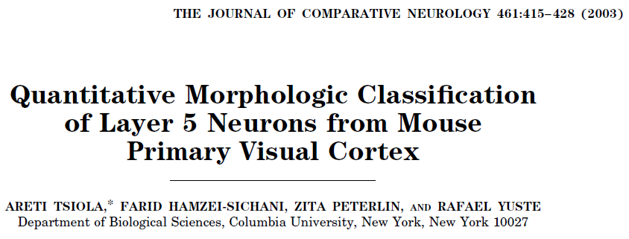
Our goal was to define morphologic classes of cortical neurons in layer 5 of the mouse visual cortex using quantitative criteria.
Layer 5 was chosen for several reasons. It is the main output layer of the cortex; it is easy to define even without counterstaining; and its large pyramidal cells have been subject to intense physiological, biophysical, anatomic, and theoretical studies in the past decades.

Slide 35
the primary visual cortex was defined in coronal sections by using different histologic methods. In sections processed with cresyl violet, the primary visual cortex was characterized by the darker staining of layer 4 due to the higher density of small cells (Fig. 1A).
A: Nissl stain. Note the prominent layer 4 due to the high density of small granule cells.
Arrowhead points to the distinct border between layers 4 and 5.
Scale bars 100 um in A

Slide 36
A similar pattern was seen with cytochrome oxidase staining (Fig. 1B).
Finally, we used myelin staining (Fig. 1C), because the medial border of the primary visual cortex can be detected by myelin fibers extending perpendicularly to the cortical layers reaching layers 2/3, as well as by two myelin plexi extending horizontally in layers 4 and 5.
B: Cytochrome oxidase staining. Arrow points to the intense staining near layer 4.
C: Myelin stain. Arrow points to the medial border of V1.
Scale bars 500 um in B,C.

Slide 37
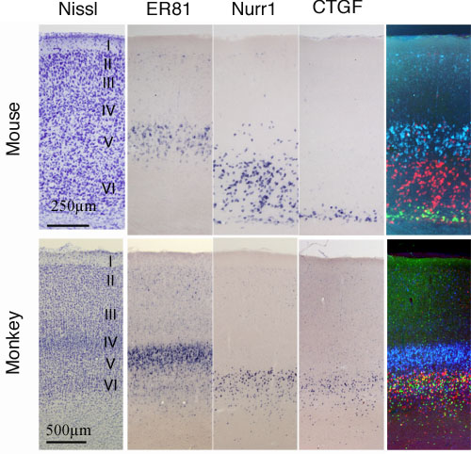
Lamina structure of neocortex

Slide 38
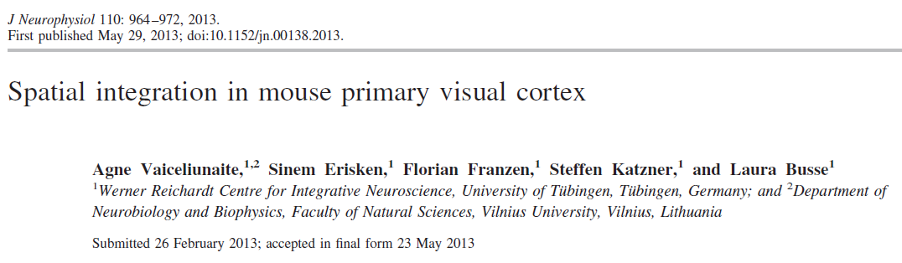
We computed the current source density (CSD) from the second spatial derivative of the local field potentials (Mitzdorf 1985) evoked by a full-field checkerboard reversing in contrast.
We determined layer 4 as the center of the initial current sink (Maier et al. 2011) and assigned recording sites to supragranular, granular, or infragranular laminae.
relative cortical depth, where 0 represents the middle of layer 4 as determined by CSD analysis.

Slide 39
The influence of cortical depth on neuronal responses in mouse visual cortex- preprint
We sought to determine how the response properties of neurons in mouse V1 depend on cortical depth.
Unlike in cats and primates where the thalamic inputs to the middle layers of cortex are constrained within layer 4 (Gilbert and Wiesel, 1979; Friedlander and Martin, 1989), in mice the inputs ramify extensively into layer 2/3 (Kondo and Ohki, 2016; Sun et al., 2016; Ji et al., 2015; Nakamura et al., 2007).
Based on the cell count and on the delineation of layers in the literature (Kondo and Ohki, 2016; Sun et al., 2016; Durand et al., 2016; Ji et al., 2015), the three superficial depths (150 μm, 200 μm, and 250 μm) are within layer 2/3, the 350 μm depth is within layer 4, and the 300 μm depth is near the border of layers 3 and 4 and so is difficult to classify.

Slide 40
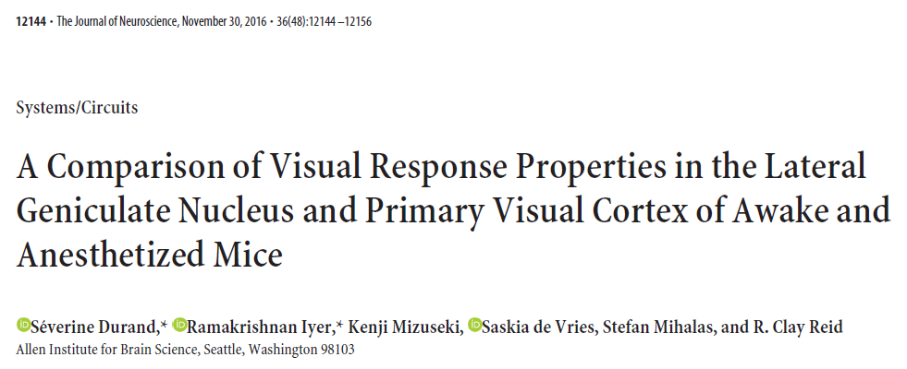
For 20 of 25 experiments, the laminar location of cortical neurons was determined by comparing the location of recording sites relative to the tip with the laminar boundaries from the DAPI staining. The mean depth for each layer was 125.62 9.77 (layer 1), 22111.32 (layer 2/3), 140.26.11 (layer 4), 245.29.27 (layer 5), and 210.29.05m(layer 6).
Fig1: This single shank probe covers 620 m of cortical depth, allowing recording in layers 2/3 through 6

